Slide 1

Providing feasible and realistic counterfactual explanations
Team: Shubham Sharma, Jie Hua

Slide 2
CONTENTS
Counterfactual explanations: Definition and objective 1
Existing work: Flexible solution using a custom genetic algorithm
Improving speed: Parallelizing the Genetic algorithm
Objective 2: Providing sparser solutions
Objective 3: Handling correlated features
Black-box robustness measure: motivation
Objective 4: Producing realistic explanations for robust classifiers

Slide 3
Counterfactual Explanation
A counterfactual explanation is a point close to the input point but its prediction is different.
Person | Features | Original | Counterfactual
Alice | Gender Income | Female 30,000 | Female 60,000
Bob | Gender Income | Male 30,000 | Male 50,000
Notes:
First, a counterfactual explanation is …
Like in this example, there are two given data points Alice and Bob. And they are both rejected by a machine learning model of their loan request. So the counterfactual provides the explanation that if you increase your income to 60,000 and 50,000 respectively then you can be approved.

Slide 4
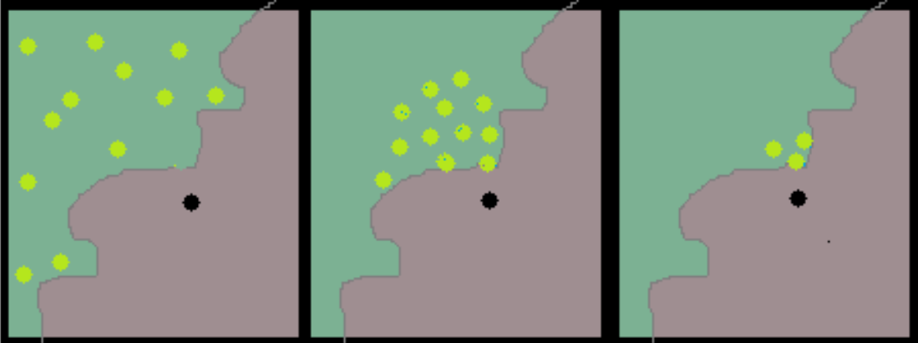
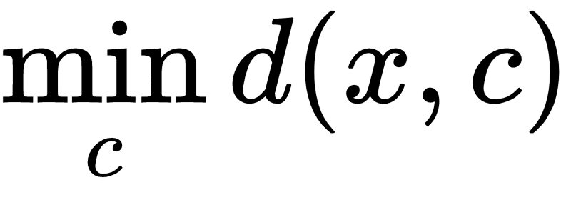
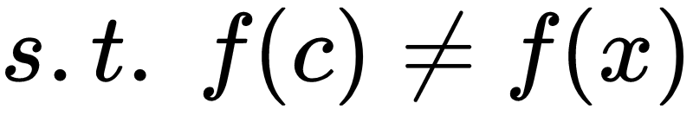
Counterfactual Problem Definition
Data point
Counterfactual explanation
Objective 1:
Notes:
More formally, given an input data point X and a machine learning model F, a counterfactual explanation is a new data point C that is as close as possible to the input data point but for which the model predicts a different outcome. Like in the graph on the right side. The black point is the data point and the green point is the counterfactual point which is on the other side of the decision boundary.

Slide 5
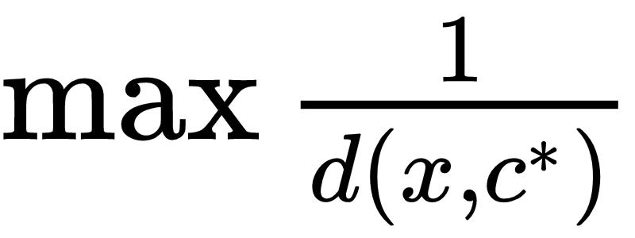
Genetic Algorithm
Non-linear, non-convex, mixed-integer
NP-Hard optimization problem
Sub-optimal solution
Sample based.
Reference: "Evaluation of Model Robustness via Interpretable Counterfactuals." Shubham Sharma, Jette Henderson and Joydeep Ghosh, ICLR 2019 Workshop on SafeML
Notes:
Unlike the actionable recourse paper we talked about which focuses on linear model. We want our tool to be model agnostic, and data agnostic. Which means that the optimization problem is...
Since it is hard to find the optimal solution, we use genetic algorithm to find sub-optimal solution. It is a sample based approach,

Slide 6
Distance function
Tabular data without training data:
L₁ norm for continuous features and matching distance for categorical features
Where n_{con} and n_{cat} are the number of continuous and categorical features, respectively. n=n_{con} + n_{cat}
Notes:
Another question is that how we define distance. The distance function should be different for different dataset and different data type in order to provide realistic similarity to help human understand the counterfactuals.

Slide 7
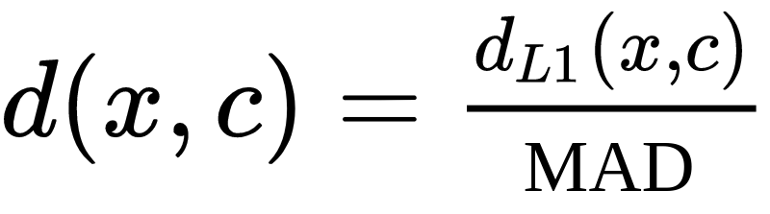
Distance function
Tabular data with training data:
L1 norm normalized by median absolute deviation (MAD)^{[1]}
[1] Sandra Wachter, et al. Counterfactual explanations without opening the black box: automated decisions and the gdpr. Harvard Journal of Law & Technology, 31(2):2018, 2017.
Notes:
If we have access to the training data, as argued by this paper, we can normalize the previous distance function by the ...which is defined as this. What it does is that it induces sparisty so that only a small number of features are changed. This makes the counterfactual easier to understand by human.

Slide 8

Distance function
Image data:
Structural Similarity Index Measure (SSIM), which has been shown to be a better measure of what humans consider to be similar images^{[2]}
[1] Zhou Wang, Alan C Bovik, and Ligang Lu. Why is image quality assessment so difficult?, 2002
Notes:
For image data, we choose the SSIM to compute distance. I will not go into details. In this paper, it shows that SSIM provide a distance function for image that is more similar to human.

Slide 9
Flexibility
Model and data agnostic: provide black box explanation. Could be better with training dataset but isn’t required.
Custom constraint: the user can easily define any constraint on how the features can be changed.
Multiple explanation: allows a user to choose how many explanations they want.
Notes:
Advantages of using the custom Genetic algorithm are...

Slide 10
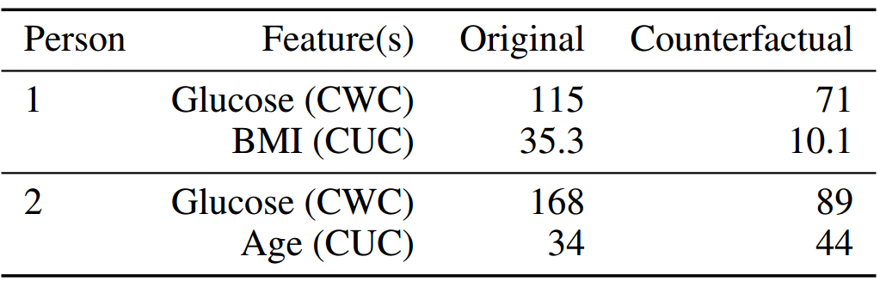
Results
Pima Indians Diabetes data set with neural network
counterfactuals with constraints (CWC)
counterfactuals unconstrained (CUC)
Notes:
for person 1, when we provide constraints (CWC), the explanation is: If your glucose is 71 instead of 115, you wouldn’t have been at the risk of diabetes.
Unconstrained features lead to infeasible solutions (BMI 10.1) or unchangeable features (age) being changed
Demonstrates flexibility since user can specify any constraint

Slide 11
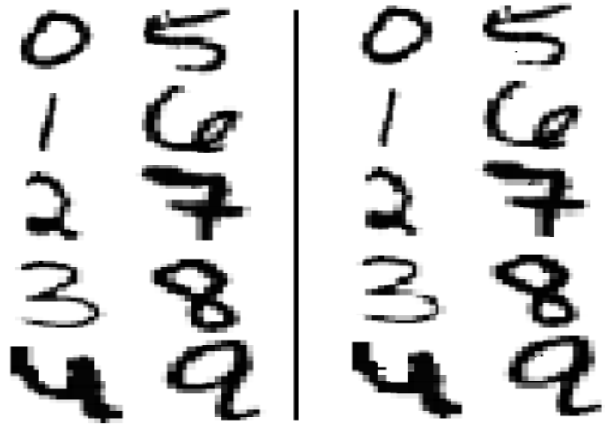
Results
Original
Counterfactual
CNN on MNIST
99.46% test accuracy
Notes:
The genetic algorithm can generate counterfactual points very close to the original data points.
It also shows that counterfactual explanation points can easily be used to generate adversarial data to evaluate the robustness of a black box model.

Slide 12
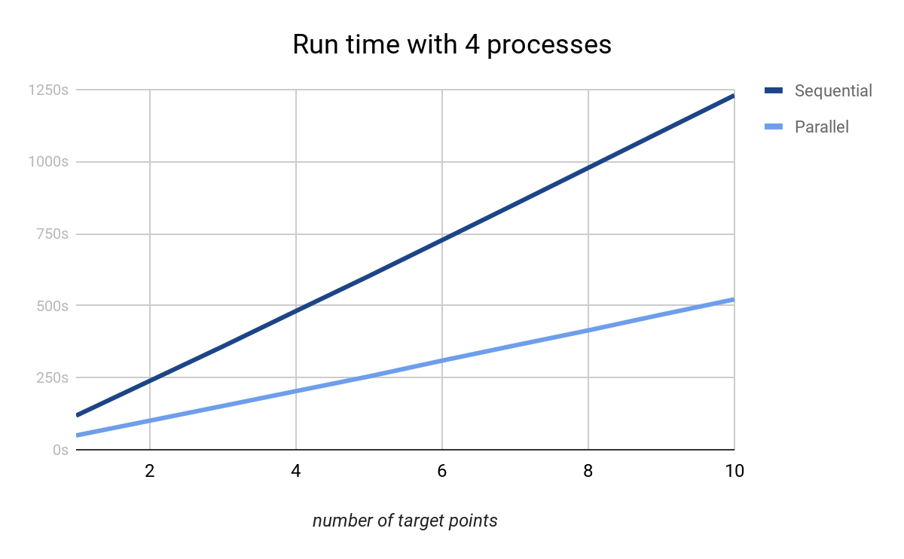
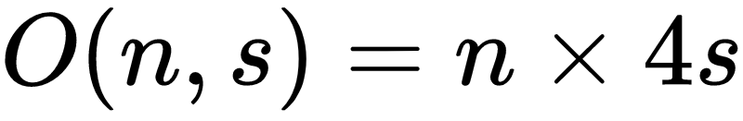
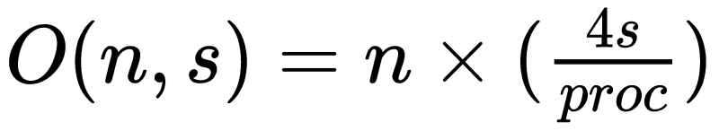
Genetic Algorithm ---- Parallel
Sequential:
Parallel:
Where n is the number of generations, and s is the size of the population.
proc is the number of processors.
Notes:
One drawback of using genetic algorithm is that if we want to have a solution close enough to the data points, we would need enough population and generation which impose a lot of computation.
So the first improvement we made is that ….

Slide 13
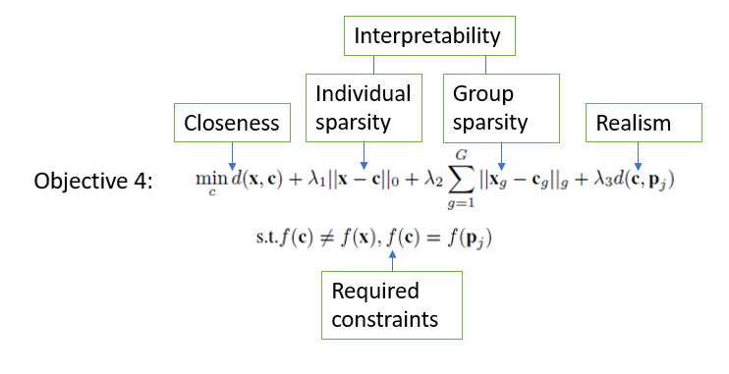
Realistic and Interpretable explanations
New objective:

Slide 14


Interpretable counterfactuals
While the MAD scaling encourages sparser solutions, it does not guarantee sparsity
Solution: Modification of the objective
Here ||.||₀ is the L0 norm
A higher value of λ would produce sparser solutions that may be further away from the input
Objective 2:

Slide 15
Results
PIMA Diabetes dataset with original objective vs objective 2 (with all features unmuted)
Feature | Input | Counterfactual 1 | Counterfactual 2 | Counterfactual 2 increased sparsity
No. of pregnancies | 1 | 1 | 1 | 1
Glucose | 85 | 96 | 109 | 96
Blood Pressure | 66 | 66 | 66 | 66
Skin Thickness | 29 | 29 | 29 | 29
Insulin | 0 | 0 | 0 | 0
BMI | 26.6 | 31.40 | 32.97 | 37.6
DiabetesPedigreeF | 0.351 | 0.351 | 0.351 | 0.351
Age | 31 | 36 | 31 | 31

Slide 16
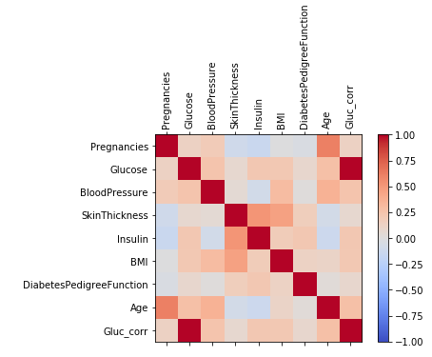
Problem: Correlated features
When encouraging interpretable (sparser) solutions, correlated features might not change together, leading to infeasible explanations
Example: We add a column to the diabetes dataset with a correlated feature
Feature | Input | Counterfactual2
Glucose | 183 | 160
Gluc_corr | 366 | 366

Slide 17



Correlated features: Solution
Solution: Modify the objective, add a group sparsity measure
Where
Groups are determined using a correlation measure, such as Pearson’s correlation. Correlated features are grouped together
Objective 3:

Slide 18
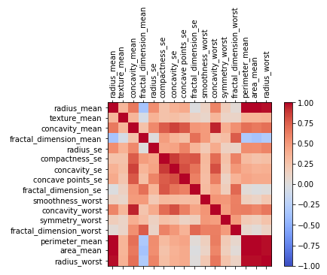
Example: Cancer dataset
Feature | Input | Counterfactual2 | Counterfactual3
Radius_mean | 17.99 | 18.024 | 18.024
Perimeter_mean | 122.8 | 133.64 | 124.106
Area_mean | 1001 | 1001 | 1001.15
Radius_worst | 25.38 | 25.38 | 25.78

Slide 19
Black-box robustness measure
Another way of looking at counterfactuals: adversarial attacks
We created the first ever black-box model robustness score, telling us how robust a model is. The intuition is that when counterfactuals are close to the original image on average, it is easier to fool the network
If the counterfactuals are near optimal, they would be representative of the decision boundary of the network. Hence, the distance to the input on average would give a measure of robustness
The score can also be used to compare different models on the same dataset to ensure that the model deployed is more robust

Slide 20
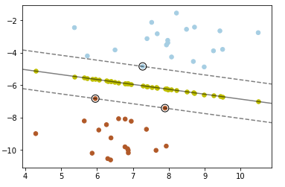
Counterfactual explanations for robust classifiers
Claim: The more robust a classifier is with respect to adversarial attacks, the more “unrealistic” the generated counterfactual explanations would be on average
Reason: The more robust a classifier is, the more the training points would be away from the decision boundary on average, and hence a generated counterfactual might be away from any real training point
Example:

Slide 21

Solution: Realistic counterfactual explanations
Modify the objective:
Here p_{j} is a measure of the distribution of training points in the class j. For our experiments, p_{j} is the median of the training points of class j
For a binary class problem, class j is the class where x doesn’t belong. For a multi-class problem, either the class j would be specified, otherwise we find the counterfactual with objective 3 only and then run objective 4 with class j as the class of the counterfactual result from the previous run
Objective 4:

Slide 22
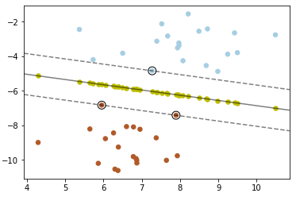
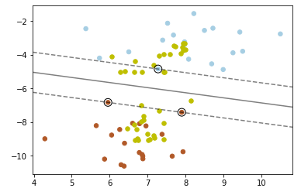
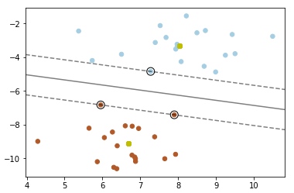
Results: SVM on synthetic data
Objective 3 Objective 4 low λ₃ Objective 4 high λ₃
Blue and Red points are training points
The yellow points represent counterfactuals

Slide 23
Summary of objective
New objective:
Note: tuning λ₃ is a direct consequence of the robustness score. Tuning λ₂ follows from the extent of correlation. Different values of λ₁ can also be used to provide multiple explanations

Slide 24
Summary and future work
We created a new holistic objective addressing a number of problems in the original counterfactual explanation problem
Since we use a custom genetic algorithm, we do not need to worry about the convexity of the objective and modifying it is easy
We are working on experiments with real datasets with the final objective in mind, to highlight the key usefulness of each term
It is also interesting that since these counterfactuals approximate decision boundaries, they might be useful in finding better surrogate models for blac-box models
It would also be interesting to numerically investigate the trade-off between robustness and counterfactual explanation realism

